Slide 1
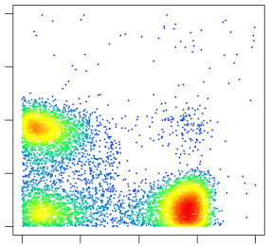
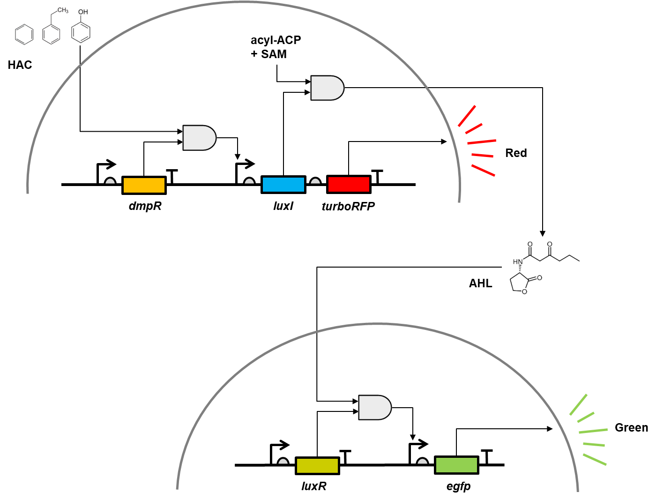
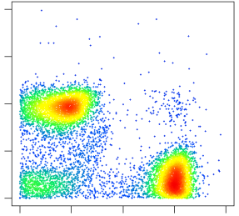
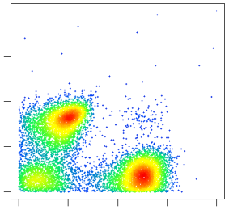
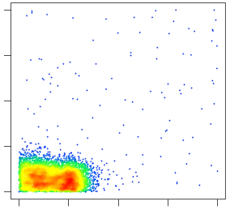
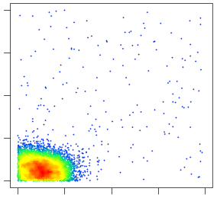
(B)
Phenol 1000μM
(A)
RFP
0 10 10² 10³ 10⁴
Phenol 100μM
RFP
0 10 10² 10³ 10⁴
Phenol 10μM
RFP
0 10 10² 10³ 10⁴
Phenol 1μM
RFP
0 10 10² 10³ 10⁴
Figure 1. Paired microbial biosensor construction. (A) schematic diagram of the paired microbial biosensor. Hazardous aromatic compounds (HAC) activate DmpR which expresses LuxI and turboRFP in a detector cell. LuxI converts S-adenosylmethionine (SAM) and an acylated acyl carrier protein (ACP) to acyl homoserine lactone (AHL) which triggers egfp expression in reporter cells. (B) Single cell level florescence distribution of the mixed microbial biosensor. Phenol molecules triggers detector cells to express red fluorescence protein (RFP) while reporter cells to produce green fluorescence protein (GFP).
Phenol 0μM
RFP
0 10 10² 10³ 10⁴
0 10 10² 10³ 10⁴
GFP

Slide 2
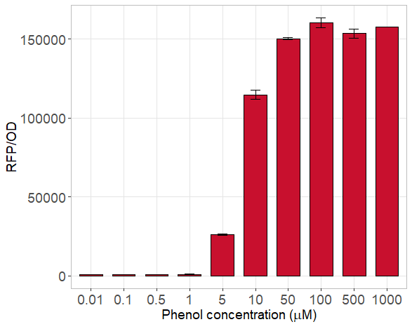
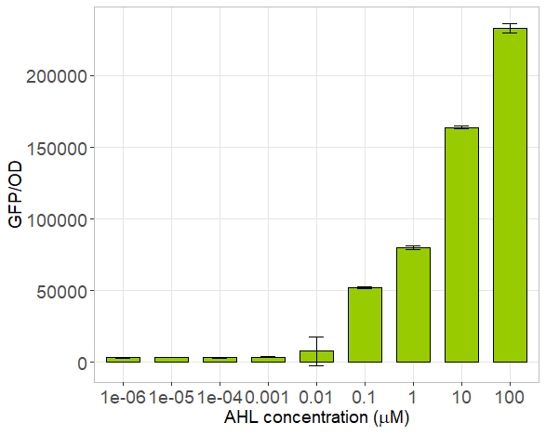
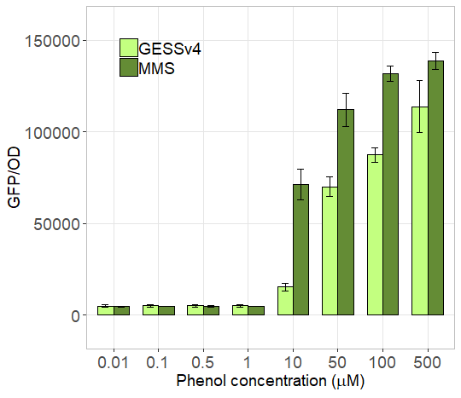
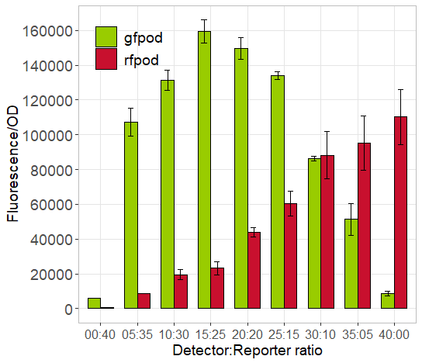
(A)
(B)
(C)
(D)
Figure 2. Characteristics of mixed microbial biosensors responding to a range of phenol or AHL concentrations. (A) Specific red fluorescence of detector cells responding to phenol. (B) Specific green fluorescence of reporter cells in responding AHL. (C)
Victor
Excitation : 485 nm
Emission : 535 nm
Excitation : 531 nm
Emission : 595 nm

Slide 3
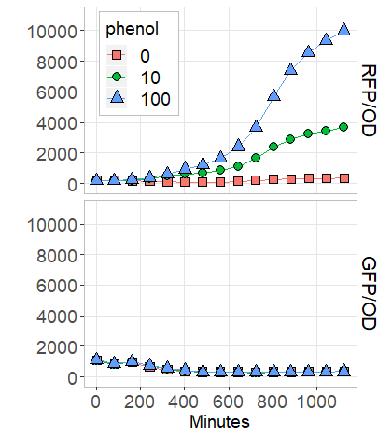
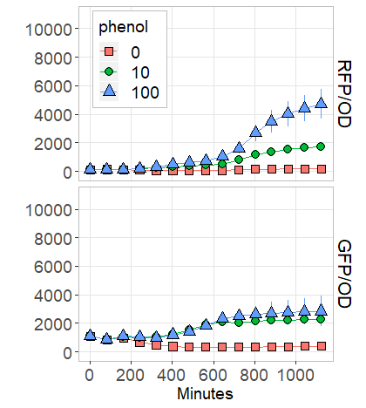
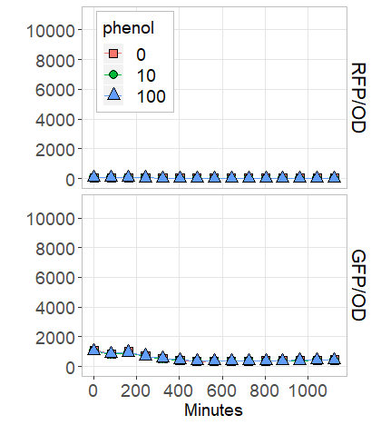
(A)
Detector only
(B)
Mixed 1:1
(C)
Reporter only
Figure 3. Leaky expression of detector and reporter cells in growth
Tecan (20 hours)
Excitation : 488 nm
Emission : 515 nm
Excitation : 553 nm
Emission : 585 nm
Notes:
성장에 따른 손실 최소화
시간 경과 전 형광 올라옴
RFP에 의한 형광 손실

Slide 4
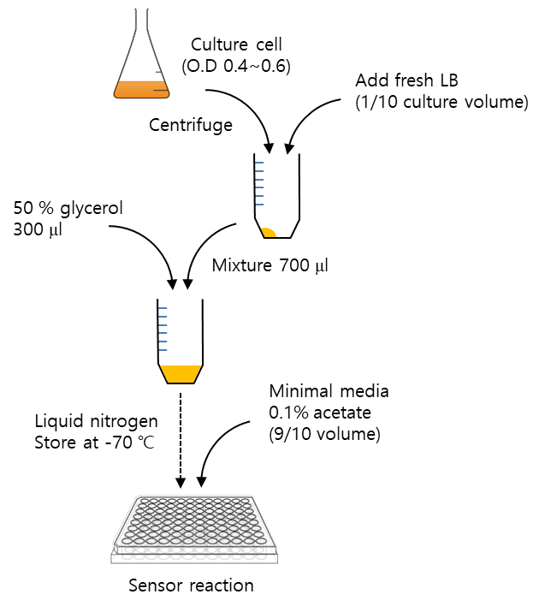
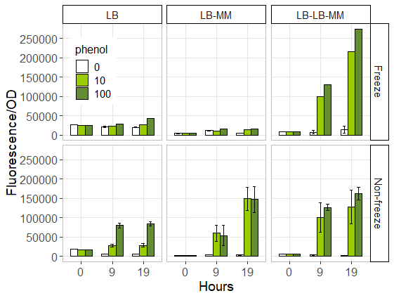
(A)
(B)
Figure 4. Freeze based mixed microbial biosensor
Victor
Excitation : 485 nm
Emission : 535 nm
Excitation : 531 nm
Emission : 595 nm

Slide 5
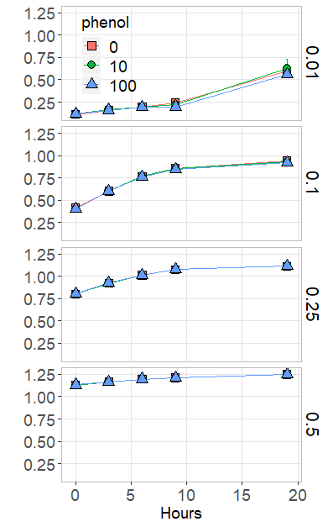
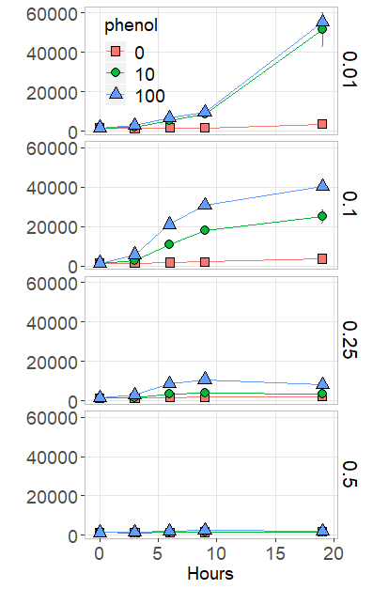
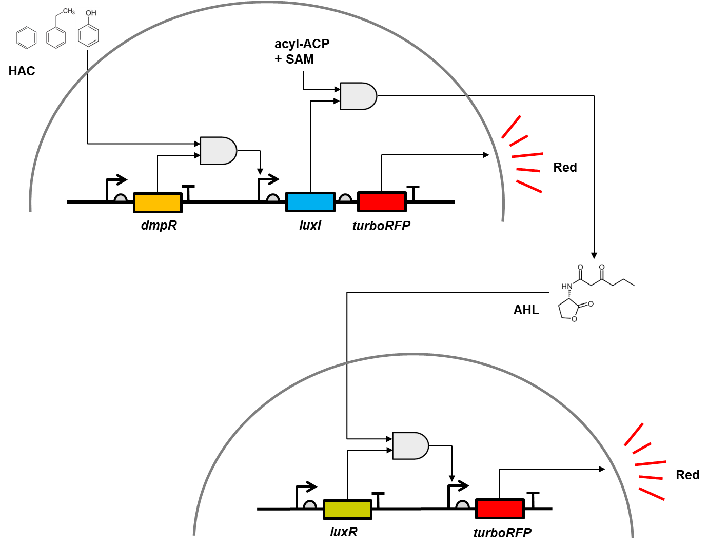
(A)
OD
(B)
GFP
(C)
Figure 5. Optimal seed ratio of freeze mixed microbial biosensors
Tecan (20 hours)
Excitation : 488 nm
Emission : 515 nm

Slide 6
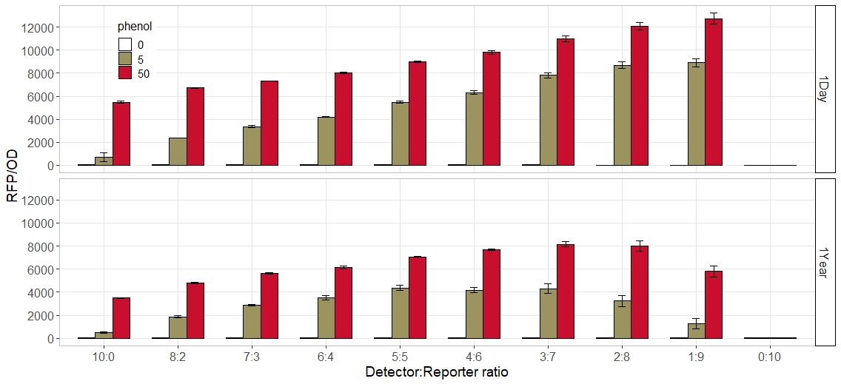
Figure 6. Freeze based
Tecan (at 10 hour)
Excitation : 553 nm
Emission : 585 nm

Slide 7
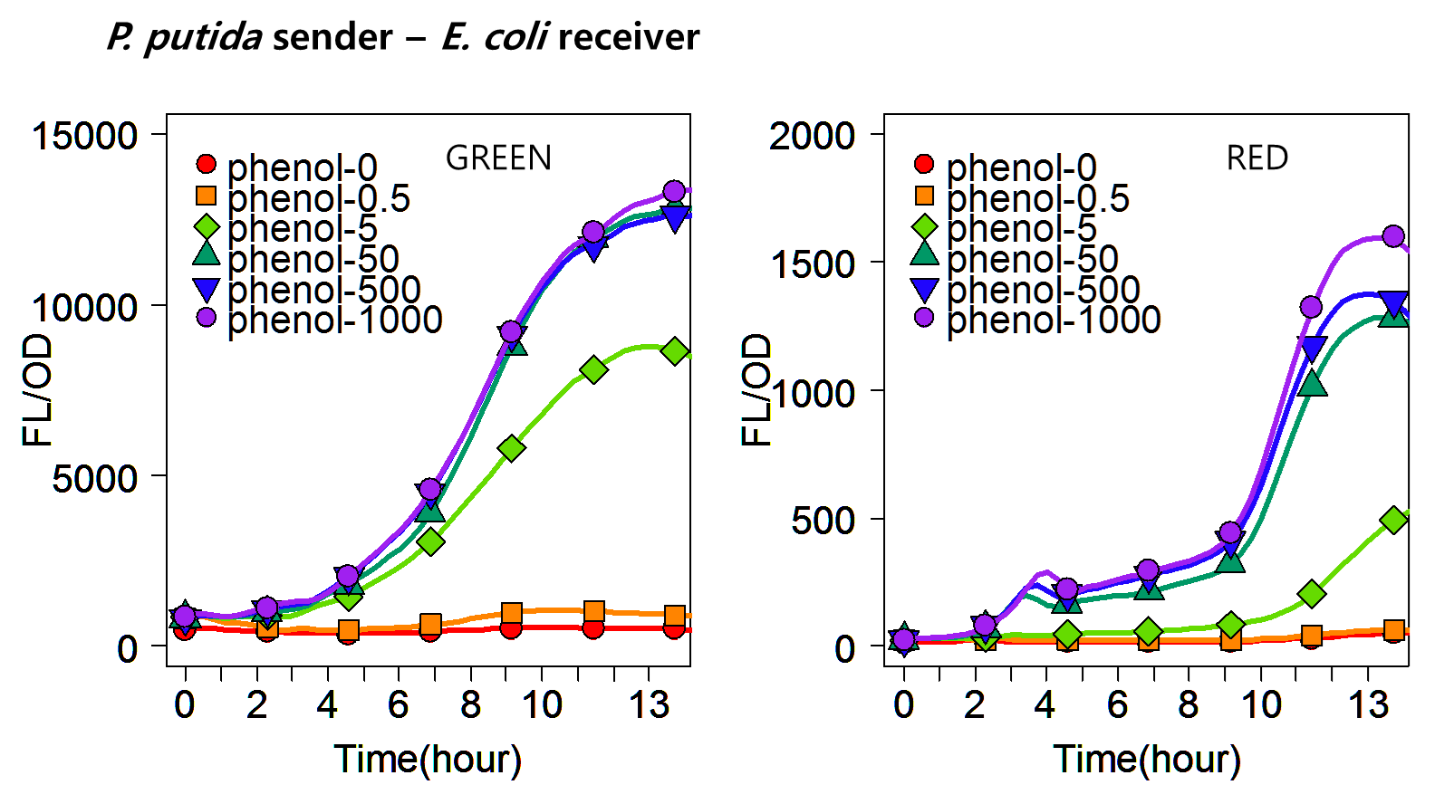
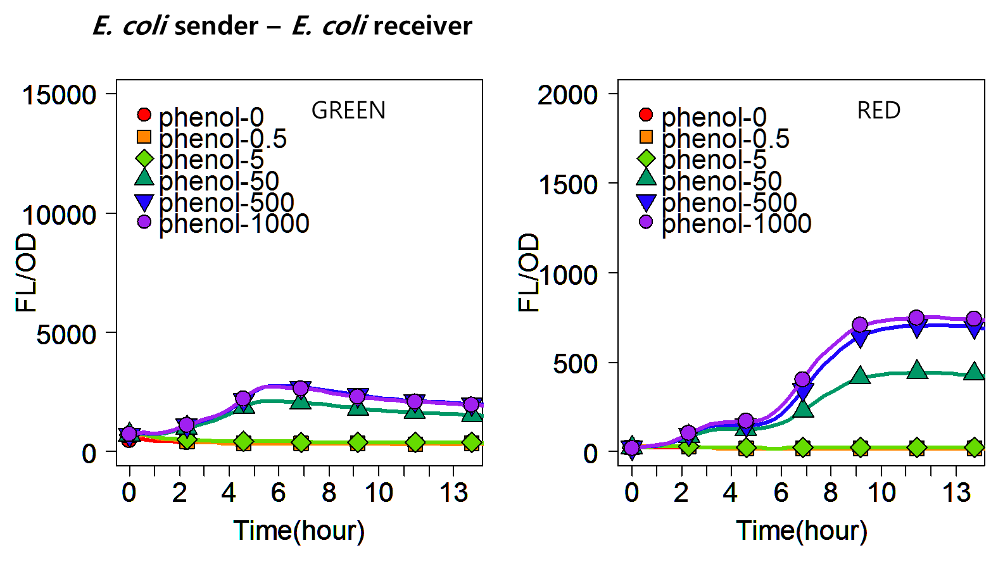
Additional results?

